Slide 1
Problem Fomulation

Slide 2
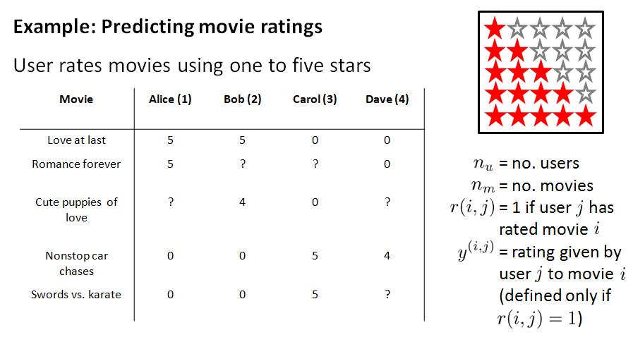

Slide 3
Content Based Recommendation

Slide 4
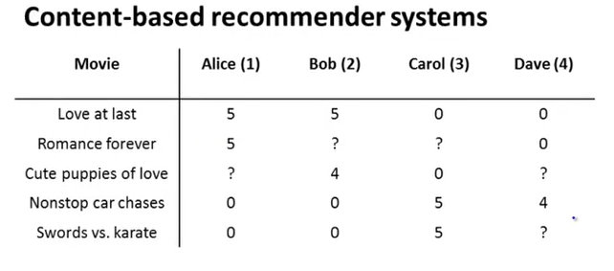
Problem Statement
Predict Missing Value

Slide 5
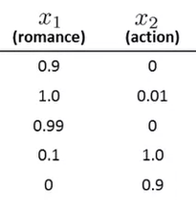

Problem Statement
$$x_{0} =1$$
Feature of each movie
Predict Missing Value

Slide 6




Problem Statement
$$x_{0} =1$$
$$θ_{1}$$
$$θ_{2}$$
$$θ_{3}$$
$θ_{4}$
Feature of each movie

Slide 7

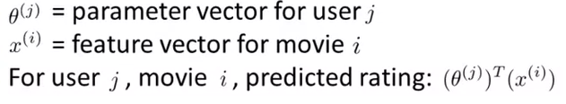
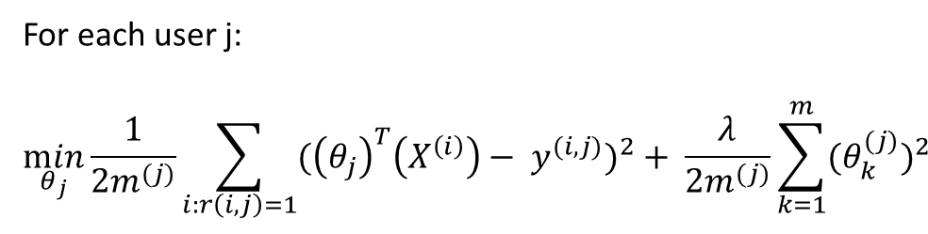
Problem Formulation
For each user j:
$$\min_{θ_{j}}{\frac{1}{2m^{(j)}}\sum_{i:r\left(i,j\right)=1}{{({\left(θ_{j}\right)}^{T}\left(X^{\left(i\right)}\right)− y^{(i, j)})}^{2}}+ \frac{λ}{2m^{(j)}}\sum_{k=1}^{m}{{{(θ}_{k}^{(j)})}^{2}}}$$

Slide 8
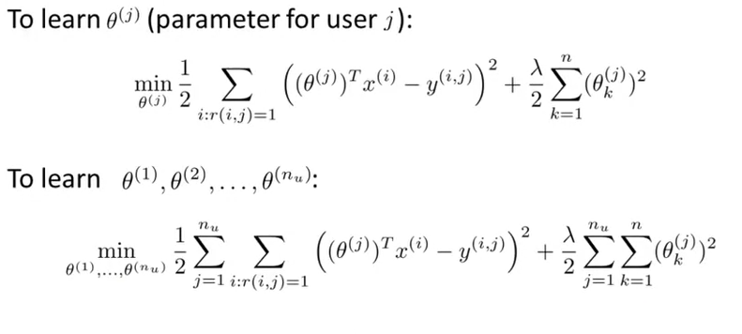
Optimization Objective

Slide 9
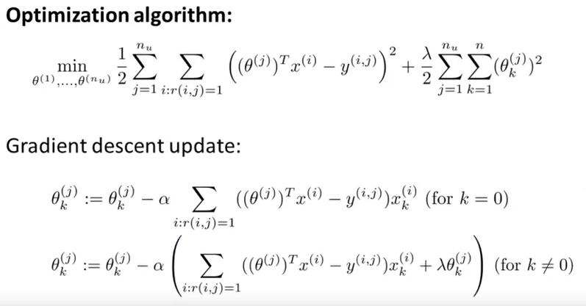
Optimization Objective

Slide 10
Content Based Recommendation

Slide 11
Problem Statement
Predict Missing Value

Slide 12
Problem Statement
$$x_{0} =1$$
Feature of each movie
Predict Missing Value

Slide 13
Problem Statement
$$x_{0} =1$$
$$θ_{1}$$
$$θ_{2}$$
$$θ_{3}$$
$θ_{4}$
Feature of each movie

Slide 14
Problem Formulation
For each user j:
$$\min_{θ_{j}}{\frac{1}{2m^{(j)}}\sum_{i:r\left(i,j\right)=1}{{({\left(θ_{j}\right)}^{T}\left(X^{\left(i\right)}\right)− y^{(i, j)})}^{2}}+ \frac{λ}{2m^{(j)}}\sum_{k=1}^{m}{{{(θ}_{k}^{(j)})}^{2}}}$$

Slide 15
Optimization Objective

Slide 16
Optimization Objective

Slide 17
Collaborative filtering algorithm

Slide 18
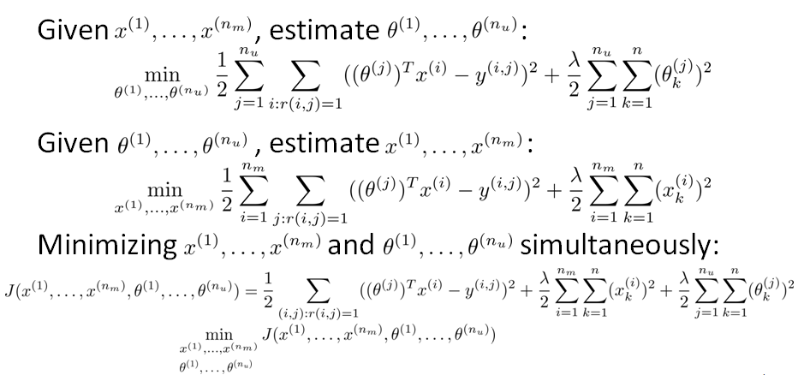
Collaborative Filtering Optimization Objective

Slide 19
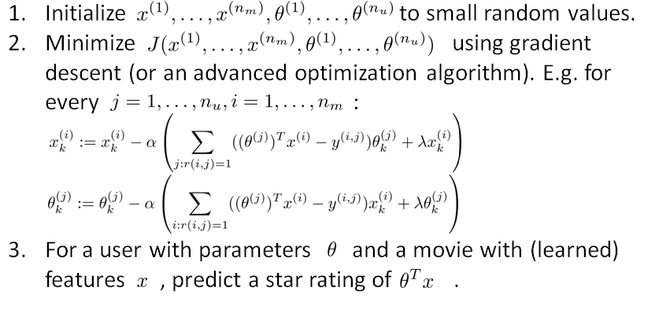
Collaborative Filtering Algorithm

Slide 20
Vectorization: Low rank matrix factorization

Slide 21
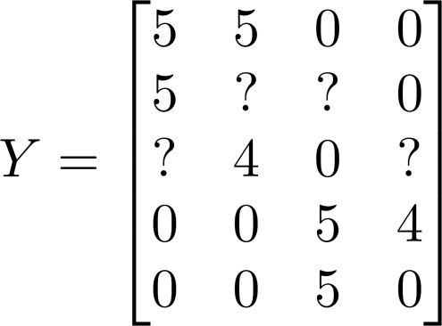
Collaborative filtering
Movie | Alice (1) | Bob (2) | Carol (3) | Dave (4)
Love at last | 5 | 5 | 0 | 0
Romance forever | 5 | ? | ? | 0
Cute puppies of love | ? | 4 | 0 | ?
Nonstop car chases | 0 | 0 | 5 | 4
Swords vs. karate | 0 | 0 | 5 | ?
Notes:
Make points have 0 mean on x1 and x2

Slide 22
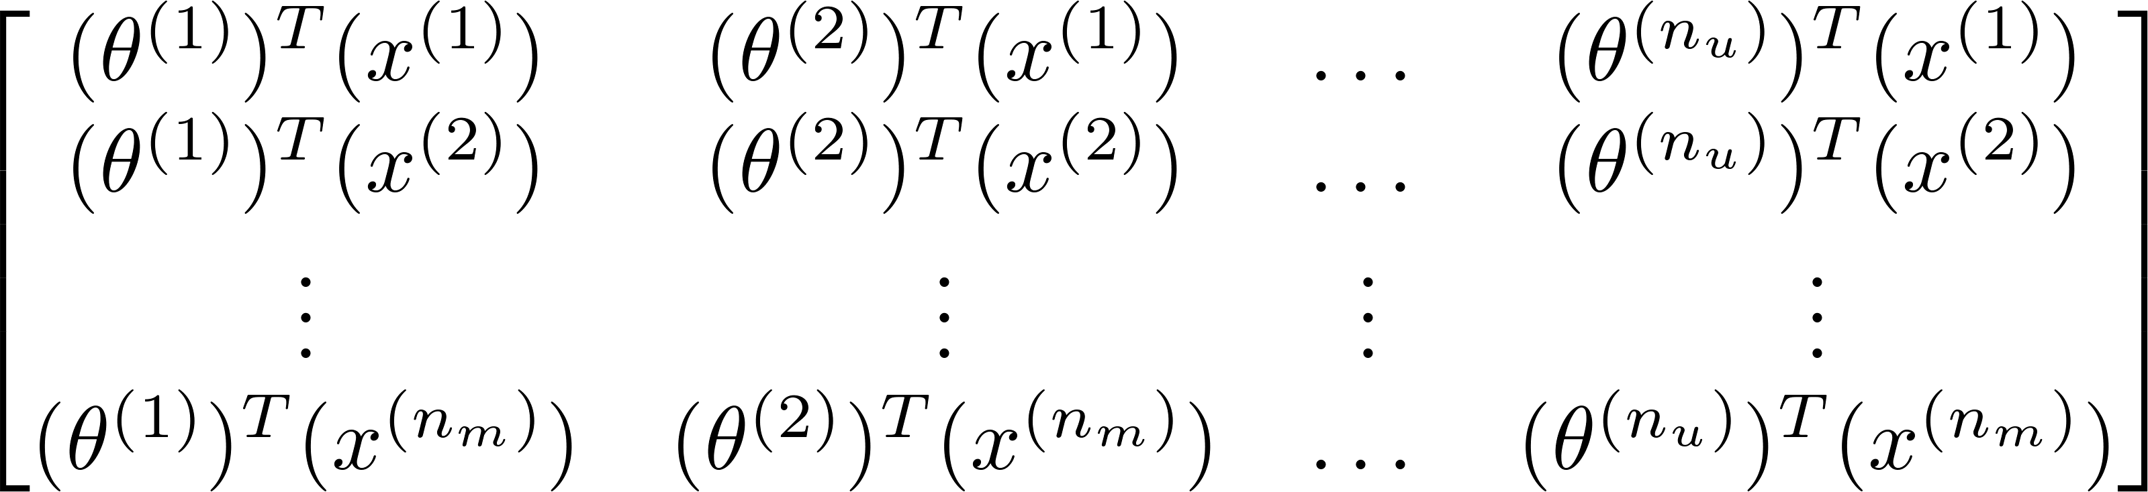
Vectorization
Collaborative filtering
Predicted ratings:
Collaborative Filtering
Notes:
Make points have 0 mean on x1 and x2

Slide 23
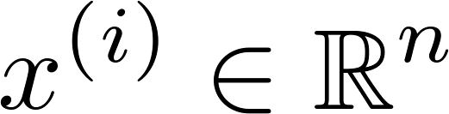
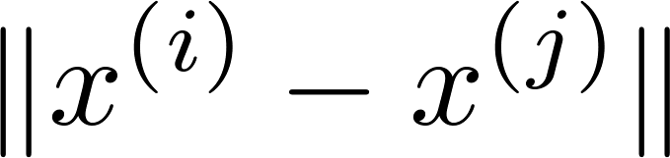
Finding related movies
For each product , we learn a feature vector .
How to find movies related to movie ?
5 most similar movies to movie :
Find the 5 movies with the smallest .
Notes:
Make points have 0 mean on x1 and x2

Slide 24
Implementational detail: Mean normalization

Slide 25
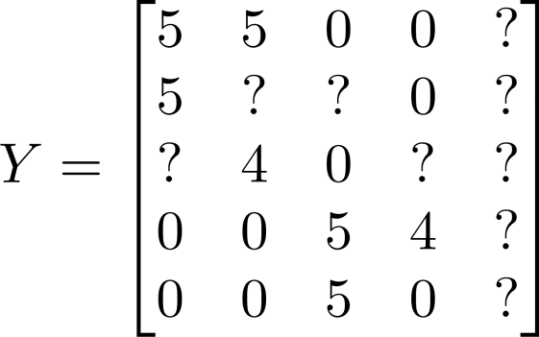


Users who have not rated any movies
Movie | Alice (1) | Bob (2) | Carol (3) | Dave (4) | Eve (5)
Love at last | 5 | 5 | 0 | 0 | ?
Romance forever | 5 | ? | ? | 0 | ?
Cute puppies of love | ? | 4 | 0 | ? | ?
Nonstop car chases | 0 | 0 | 5 | 4 | ?
Swords vs. karate | 0 | 0 | 5 | ? | ?

Slide 26
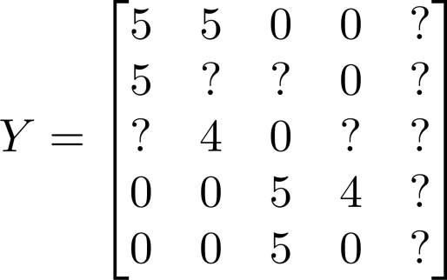
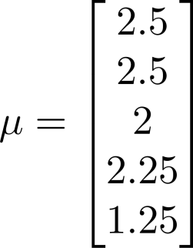
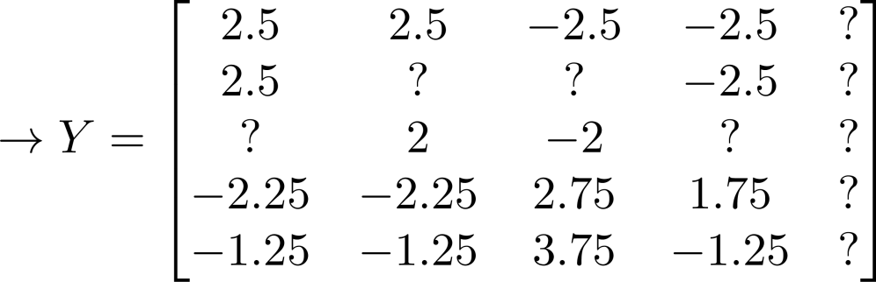

Mean Normalization:
For user , on movie predict:
User 5 (Eve):

